Slide 1

ResuMate
The Effortless Resume Evaluation Tool

Slide 2

Introduction
The project "ResuMate" goal is to develop technology that offers job searchers and students a personalized feedback and advice so they may improve their resumes and raise the likelihood that they will be contacted for an interview. To help students assess if their resumes are fit for the occupations they are seeking, we have developed the following concept. This initiative is students' oriented.

Slide 3

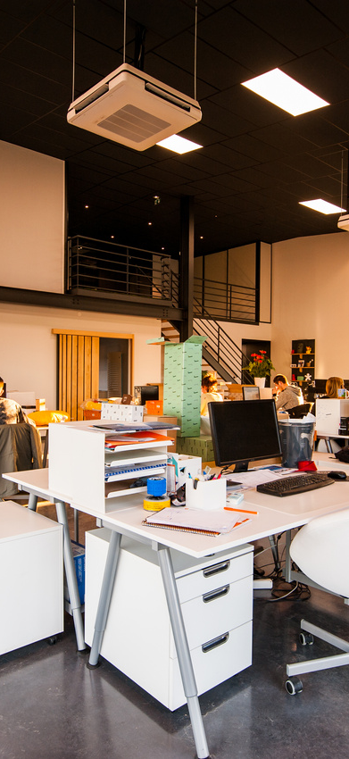
Problem Statment
Students frequently overstock their resumes with outdated and obsolete abilities. In today's resume screening, When hiring managers analyze a candidate's CV, they actually reject all of the weak ones without providing the candidates the useful insights.
[1]

Slide 4

Solution
This project has the potential to revolutionize the traditional resume screening process, providing students with the tools and guidance they need to build a strong and competitive resume, giving them a better chance of success in their job search.
Our software will scan a candidate's resume when they upload it, making recommendations about the job profile they should apply for based on historical recruiting data and market trends.
Additionally, it offers a percentage of how well his resume matches the exact industry requirements for the position he is seeking for.

Slide 5

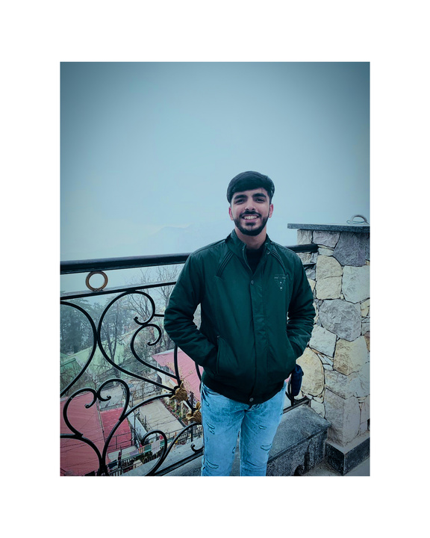
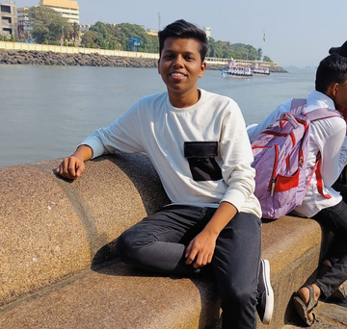

Our Best Team
United we stand, divided we fall: Our team is unbreakable!
Kalash Pruthi
Ghodke Aditya Rao
Jaya Saini
Backend
Frontend
Research and Integration
[E21CSEU0357]
[E21CSEU0312]
[E21CSEU0348]

Slide 6


Requirement Analysis
Resume Analysis Tool: A tool that can analyze the student's resume and provide feedback on how to improve it. The tool should use natural language processing (NLP) and machine learning (ML) algorithms to evaluate the resume.
Feedback Mechanism: The tool should provide personalized feedback to the student on how to improve their resume.
User Interface: The tool should have an easy-to-use interface that is accessible to students of all technical backgrounds. The interface should be intuitive, and the feedback should be presented in a clear and concise manner.
Machine Learning Algorithms
Natural Language Processing

Slide 7
Related Works
Talent Sonar[1]
Jobscan[2]
VMock[3]
While the tools mentioned above are helpful in analyzing and improving resumes, they also have some drawbacks, which include:
Lack of Personalization: Most of these tools use an algorithm to analyze the user's resume and provide feedback. However, the feedback provided may not always be personalized to the user's unique circumstances or job requirements.
Cost: Some of these tools require users to pay for premium services to access certain features or get more detailed feedback. This may be a drawback for users who cannot afford to pay for these services.
Limited Scope: Some of these tools are designed to analyze resumes for specific industries or job roles, which may limit their usefulness for job seekers in other fields. They may not provide the same level of detail or relevance for resumes outside their specialty area.

Slide 8
References
[1] Bhushan Kinge, Shrinivas Mandhare, Pranali Chavan, S. M. Chaware4, 2022, Resume Screening Using Machine Learning and NLP : A Proposed System, International Journal of Scientific Research in Computer Science, Engineering and Information Technology ISSN : 2456-3307 [.]
[2] MUNGI NAGA VENKATA SAI RAGHAVENDRA, 2022, RESUME SCREENING USING MACHINE LEARNING, Department of Computer Science and System Engineering , ISSN:0377-9254 [.]

Slide 9



Everyday-Work
Week 4: February 13-February 19
Kalash(E21CSEU0357)
Report Citation, read many research papers and did comparative analysis
Aditya(E21CSEU0312)
Training and testing of each models made from modules used in the project
Jaya(E21CSEU0348)
Designing of Home Page of our Website

Slide 10
Everyday-Work
Week 5: February 20-February 26
Kalash(E21CSEU0357)
Designed Use Case Diagram, Sequence Diagram and working on 1st part of backend
Aditya(E21CSEU0312)
Designed Activity Diagram, Class Diagram and Linkedln post and working on 2nd part of backend
Jaya(E21CSEU0348)
Designed the prototype of the webapp and working on frontend part

Slide 11
Everyday-Work
Week 6: February 27-March 05
Kalash(E21CSEU0357)
Working on 1st part of backend and learning to handle the database and citation on all the works.
Aditya(E21CSEU0312)
Posted the Linkedln post with caption and hashtags and continuing the work on back end and integration.
Jaya(E21CSEU0348)
Designed the frontend of the web app and about to finish the whole work with proper navigation.

Slide 12
Everyday-Work
Week 7: March 06-March 12
Kalash(E21CSEU0357)
Working on 1st part of backend and learning to handle the database .
Aditya(E21CSEU0312)
Continuing the work on back end and integration and final submission of Milestone 2
Jaya(E21CSEU0348)
Designed the frontend of the web app with proper navigation.

Slide 13

Thank You

